Slide 1
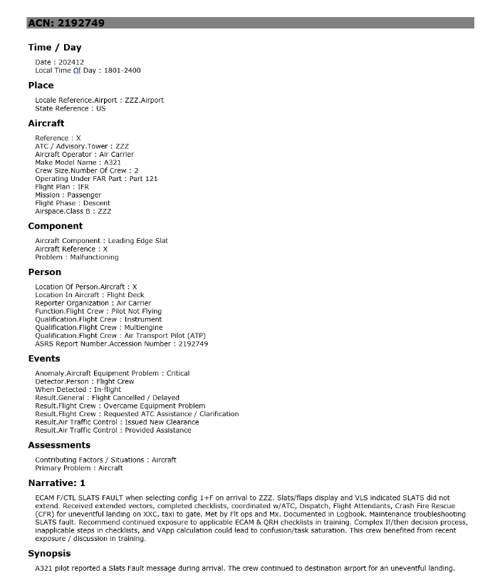

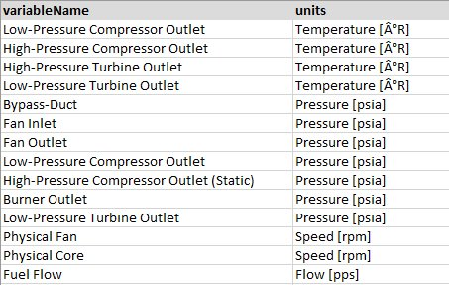


Enterprise Intelligent Maintenance
(Demo #1 – Agentic Incident Report)
IBM Maximo
Asset Management
Events Management
Event report details and AI Summary for maintenance operations
OCI Functions
Gen AI - LLM
OCI Streaming
Text-Based Event Reports
Incident Management
Signal anomaly integration for Event diagnosis
SAM Biz Analytics
(Oracle Analytics Cloud)
Numerical Telemetry Data
Things Board
IoT Streaming
OCI SAM (MSET2)
Autonomous Data Warehouse

Slide 2


Slide 3
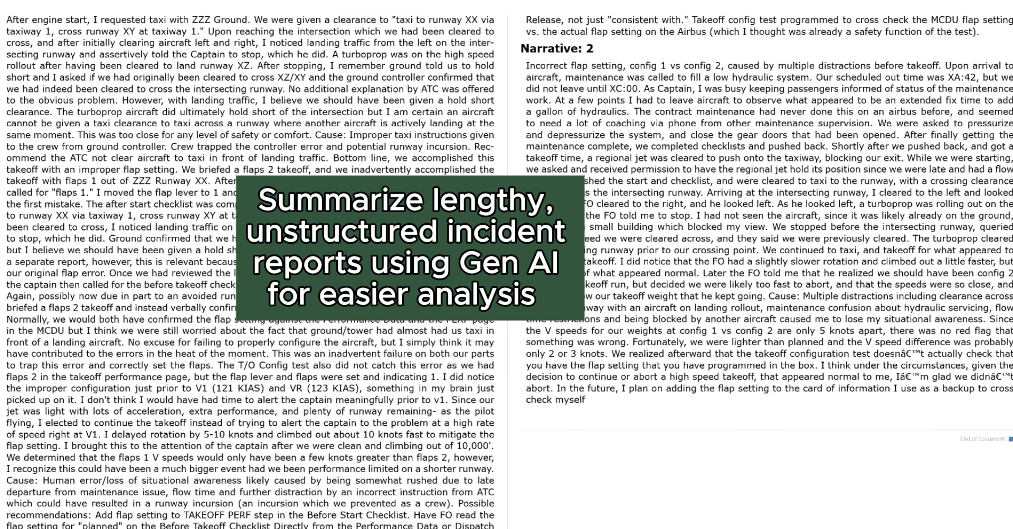
Airplane Graphic | Use Generative AI to automate and optimize incident analysis and maintenance operations
Word Doc | Summarize lengthy, unstructured incident reports using Gen AI for easier analysis

Slide 4
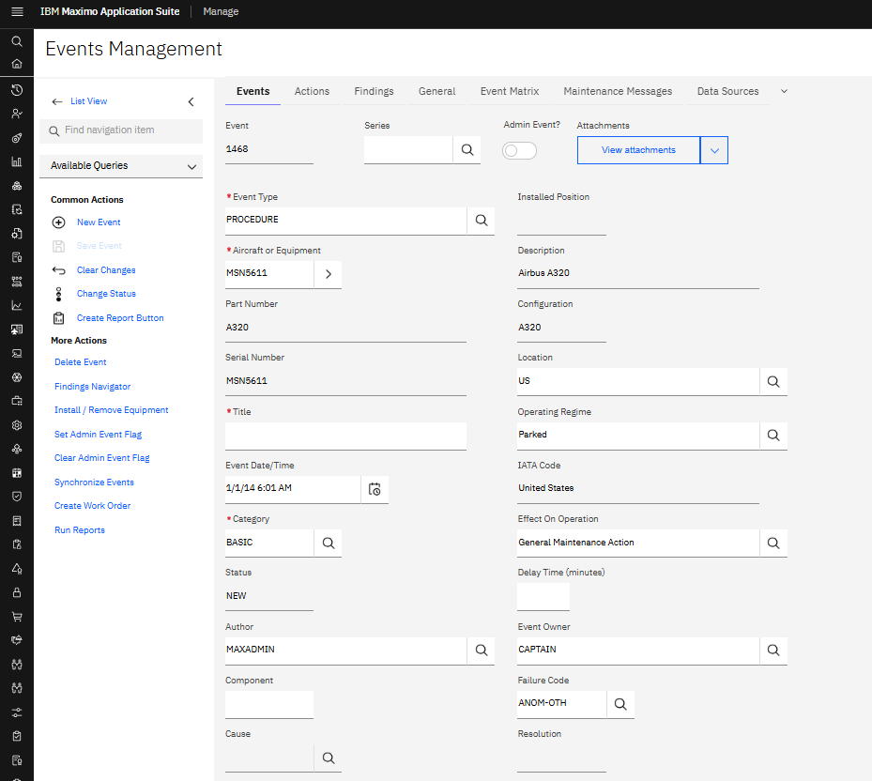
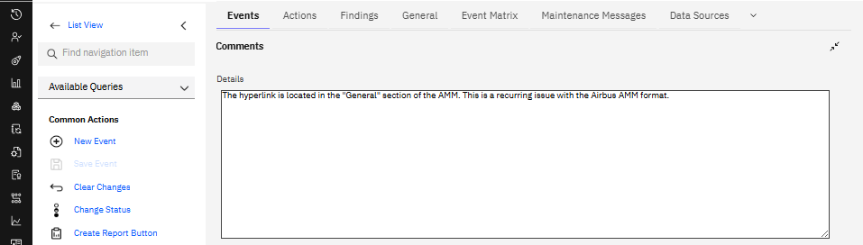
Agentic Incident Report
IBM Maximo
Asset Management
GenAI - LLM
REST API
OCI GPU
OCI GPU
OCI Events
REST API
JSON Message Producer
Stream Consumer
OCI Functions
OCI Streaming
Orchestrator Node
Text-Based Event Reports
4,000+ Incident Reports from passenger airline
User-submitted text narratives describing event
Uploaded to OCI Object Storage

Slide 5
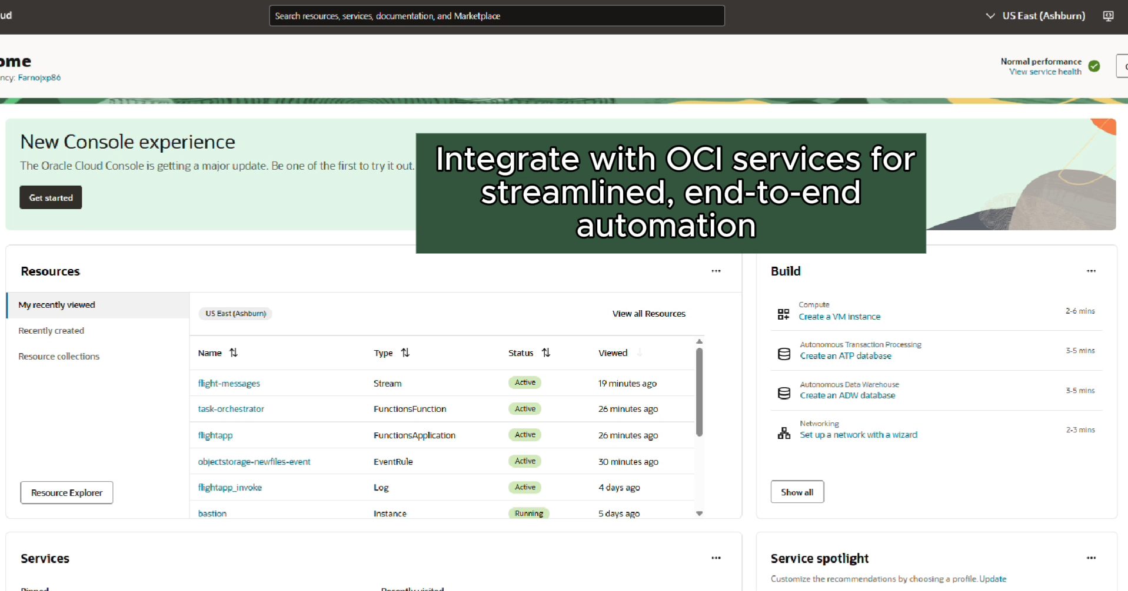
Open Shift Cluster | Deploy AI services in Red Hat OpenShift for flexible, simplified management
OCI Cloud Console | Integrate with OCI services for streamlined, end-to-end automation
OCI Compute | Run OpenShift on OCI’s hybrid CPU/GPU for enterprise-scale AI training and inference

Slide 6
Agentic Incident Report
Collect descriptive event reports and auto-trigger processing
IBM Maximo
Asset Management
GenAI - LLM
REST API
OCI GPU
OCI GPU
OCI Events
REST API
JSON Message Producer
Stream Consumer
OCI Functions
OCI Streaming
Orchestrator Node
Text-Based Event Reports
4,000+ Incident Reports from passenger airline
User-submitted text narratives describing event
Uploaded to OCI Object Storage
Format reports for AI analysis and user consumption

Slide 7
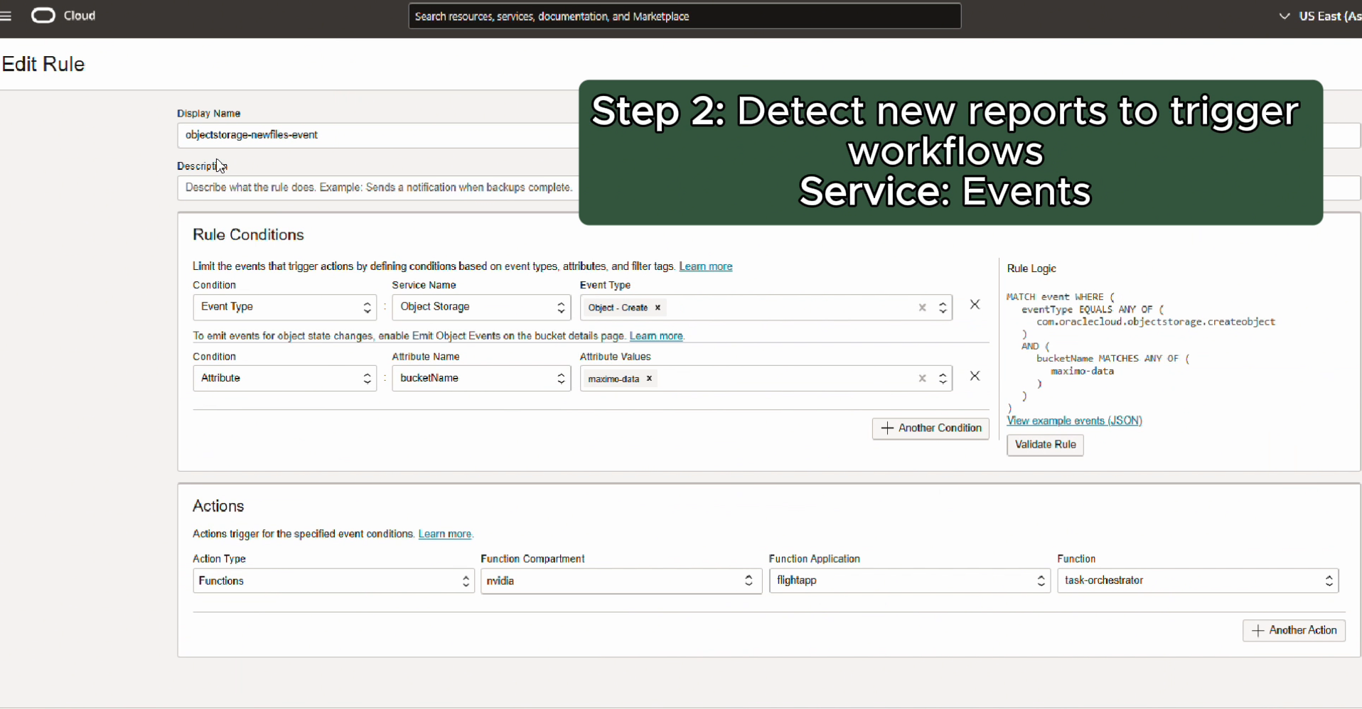
Object Storage | Step 1: Collect and store descriptive incident reports Service: Object Storage
OCI Events | Step 2: Detect new reports to trigger workflows Service: Events
OCI Functions | Step 3: Clean and transform data for downstream processing Service: Functions

Slide 8
Agentic Incident Report
AI-generated summarization of narratives and key details
IBM Maximo
Asset Management
GenAI - LLM
REST API
OCI GPU
OCI GPU
OCI Events
REST API
JSON Message Producer
Stream Consumer
OCI Functions
OCI Streaming
Orchestrator Node
Text-Based Event Reports
4,000+ Incident Reports from passenger airline
User-submitted text narratives describing event
Uploaded to OCI Object Storage
Route data reliably through streaming stages

Slide 9
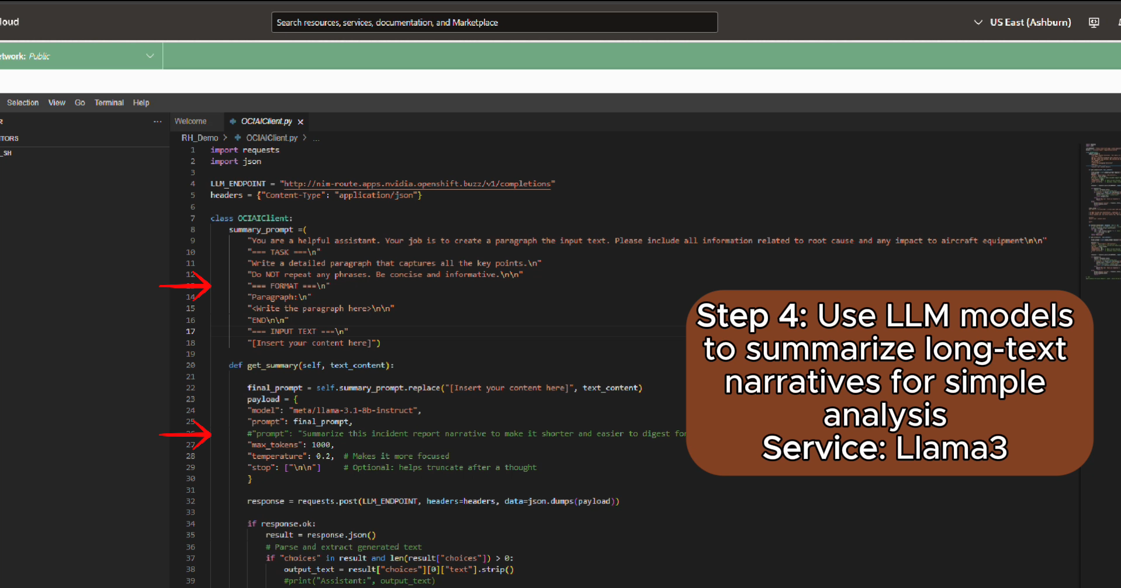
OCI Function Code Editor | Step 4: Use LLM models to summarize long-text narratives for simple analysis Service: Llama3
Bastion Host | Step 5: Stream each JSON message into enterprise IBM Maximo Asset Management Service: Streaming & Compute

Slide 10
Agentic Incident Report
Deliver event report data to enterprise asset management solution
IBM Maximo
Asset Management
GenAI - LLM
REST API
OCI GPU
OCI GPU
OCI Events
REST API
JSON Message Producer
Stream Consumer
OCI Functions
OCI Streaming
Orchestrator Node
Text-Based Event Reports
4,000+ Incident Reports from passenger airline
User-submitted text narratives describing event
Uploaded to OCI Object Storage

Slide 11
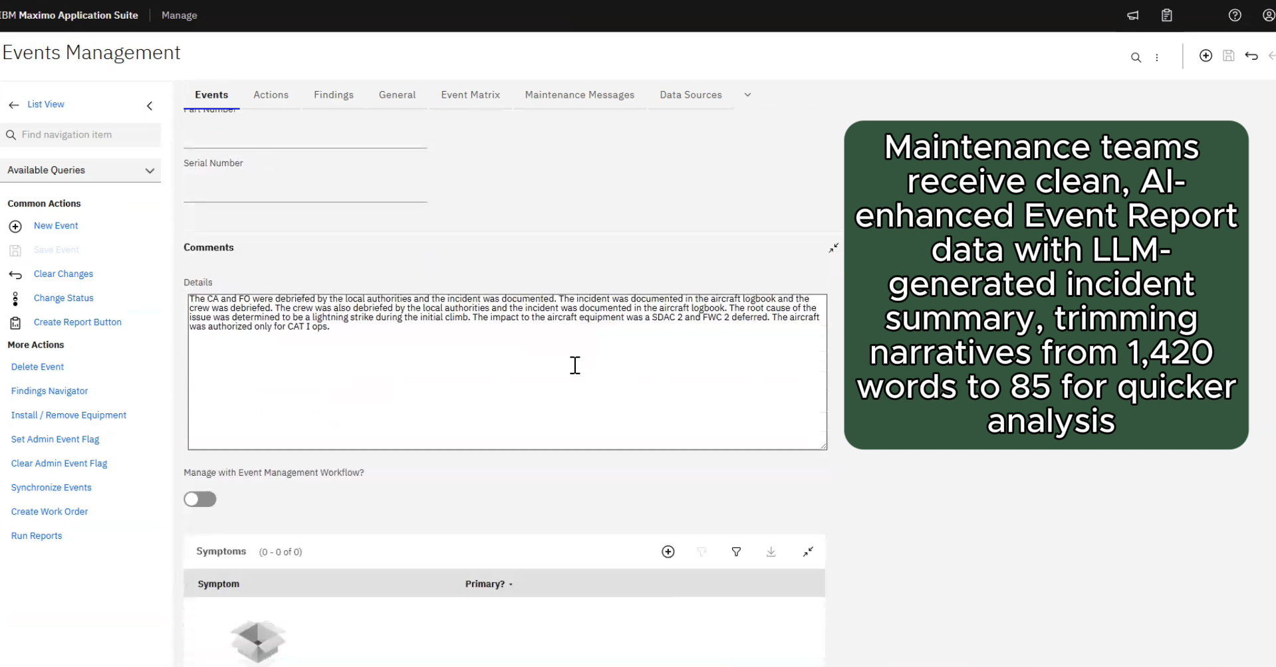
Maximo Log in | NO caption
Maximo Events | Maintenance teams receive clean, AI-enhanced Event Report data with LLM-generated incident summary, trimming narratives from 1,420 words to 85 for quicker analysis

Slide 12
Deliver event report data to enterprise asset management solution
Agentic Incident Report
Collect descriptive event reports and auto-trigger processing
AI-generated summarization of narratives and key details
GenAI - LLM
REST API
OCI GPU
OCI GPU
OCI Events
REST API
JSON Message Producer
Stream Consumer
OCI Functions
OCI Streaming
Orchestrator Node
Text-Based Event Reports
4,000+ Incident Reports from passenger airline
User-submitted text narratives describing event
Uploaded to OCI Object Storage
Route data reliably through streaming stages
Format reports for AI analysis and user consumption

Slide 13

What’s Next?
Agentic AI for Intelligent Maintenance
Service Query
Asset Management Applications
User
Document
Understanding
IoT Signal Streaming
Anomaly Detection
Query Routing AI
Operations Manager AI
Communication & Collaboration Apps
Response
Audio & Video
Transcription
Digital
Assistant
Multimodal Documents
Team Collaboration AI
Planning & Critique
Issue Tracker & Ticketing Apps
Project
Requirements
Workflow & Task AI
Automation Agent
Project Manager AI

Slide 14
Enterprise Intelligent Maintenance
(Demo #1 – Agentic Anomaly Detection)
IBM Maximo
Asset Management
Events Management
Event report details and AI Summary for maintenance operations
OCI Functions
Gen AI - LLM
OCI Streaming
Text-Based Event Reports
Incident Management
Signal anomaly integration for Event diagnosis
SAM Biz Analytics
(Oracle Analytics Cloud)
Numerical Telemetry Data
Things Board
IoT Streaming
OCI SAM (MSET2)
Autonomous Data Warehouse

Slide 16
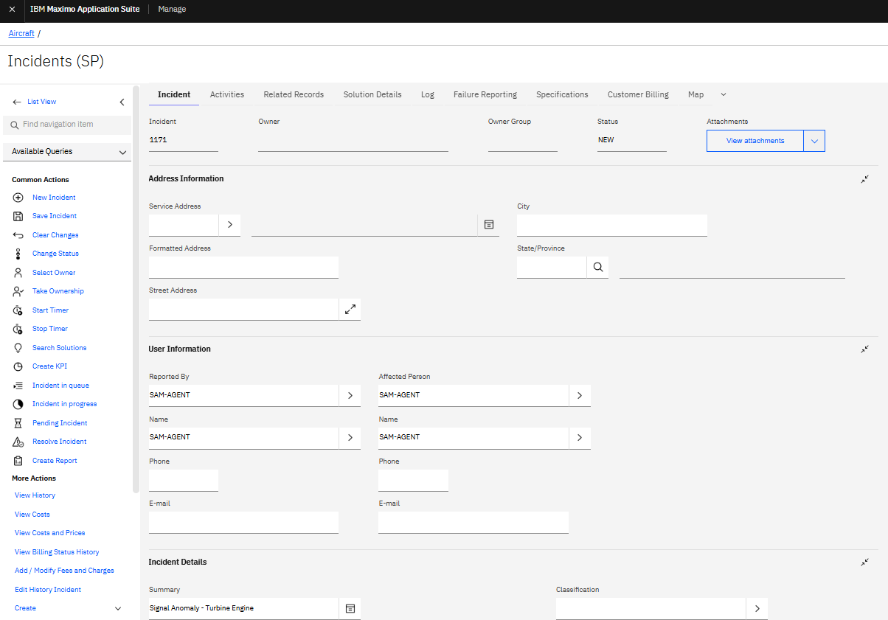
Agentic Anomaly Report
IBM Maximo
Asset Management
IoT Protocol
OCI Stream
Event
Trigger
REST API
ThingsBoard
OCI SAM
(MSET2)
Autonomous Data Warehouse
Numerical Telemetry Data
Aerospace signal data related to Jet Engine equipment signals on various aircrafts
Stored in Virtual Devices (OCI VM)
OAC-Native Direct Connection
OCI Data
Science
OCI VM
SAM Biz Analytics
(Oracle Analytics Cloud)

Slide 17
Agentic Anomaly Report
Real-time telemetry data streaming for fast issue detection
IBM Maximo
Asset Management
IoT Protocol
OCI Stream
Event
Trigger
REST API
ThingsBoard
OCI SAM
(MSET2)
Autonomous Data Warehouse
Numerical Telemetry Data
Aerospace signal data related to Jet Engine equipment signals on various aircrafts
Stored in Virtual Devices (OCI VM)
OAC-Native Direct Connection
OCI Data
Science
OCI VM
SAM Biz Analytics
(Oracle Analytics Cloud)

Slide 18
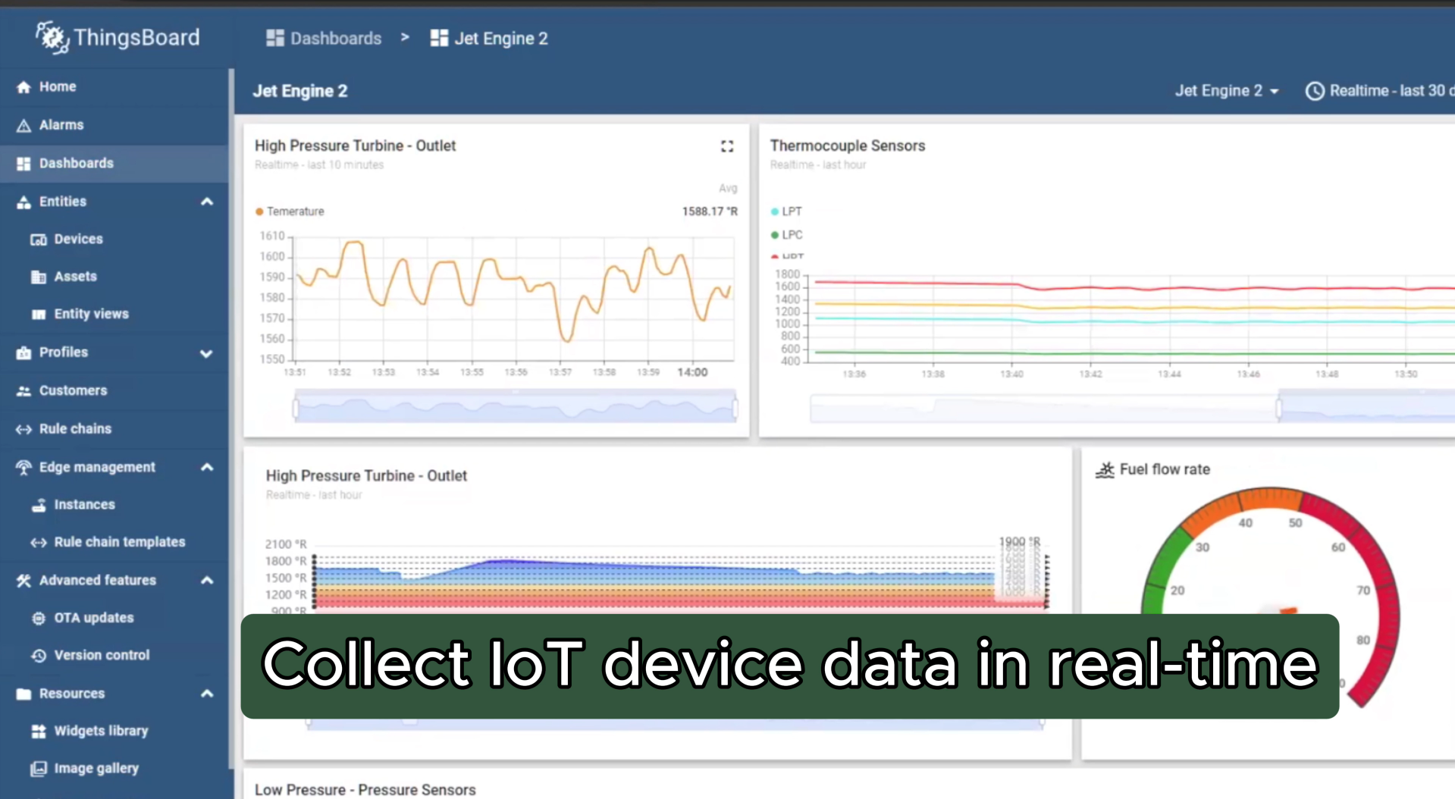

Slide 19
Agentic Anomaly Report
Apply advanced AI to detect abnormal behavior proactively
IBM Maximo
Asset Management
IoT Protocol
OCI Stream
Event
Trigger
REST API
ThingsBoard
OCI SAM
(MSET2)
Autonomous Data Warehouse
Numerical Telemetry Data
Aerospace signal data related to Jet Engine equipment signals on various aircrafts
Stored in Virtual Devices (OCI VM)
OAC-Native Direct Connection
OCI Data
Science
OCI VM
SAM Biz Analytics
(Oracle Analytics Cloud)

Slide 20
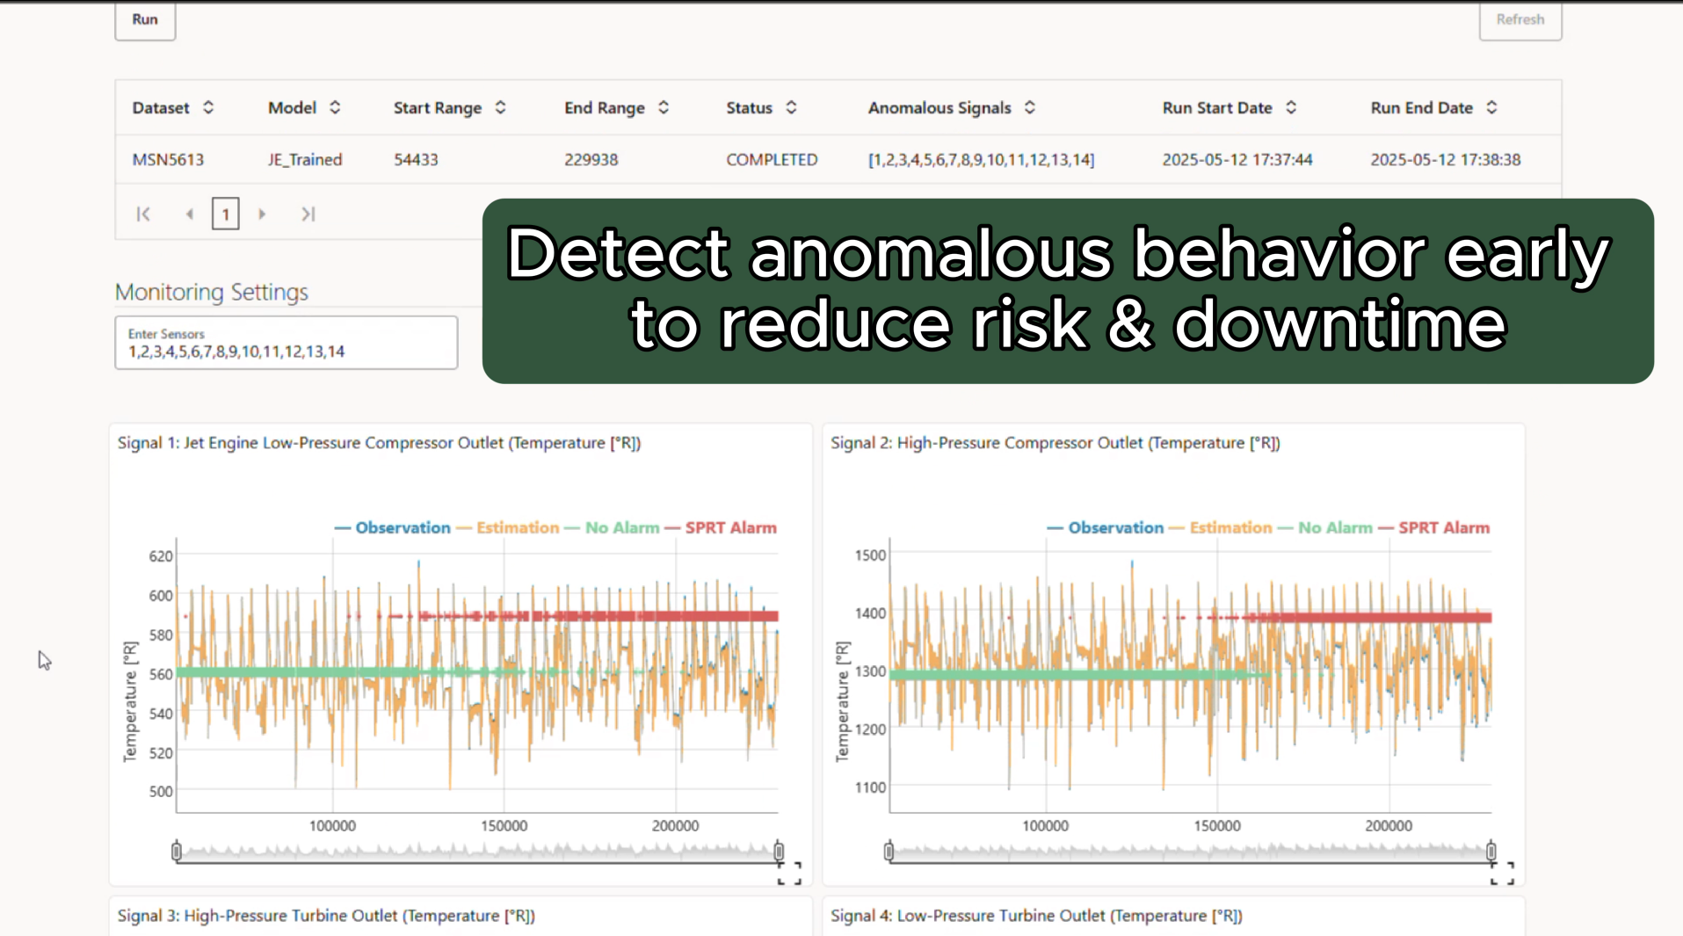

Slide 21
Agentic Anomaly Report
Efficiently track and resolve issues for operations teams
IBM Maximo
Asset Management
IoT Protocol
OCI Stream
Event
Trigger
REST API
ThingsBoard
OCI SAM
(MSET2)
Autonomous Database
Numerical Telemetry Data
Aerospace signal data related to Jet Engine equipment signals on various aircrafts
Stored in Virtual Devices (OCI VM)
OAC-Native Direct Connection
OCI Data
Science
OCI VM
SAM Biz Analytics
(Oracle Analytics Cloud)
Visualize maintenance and business data for better decision-making

Slide 22
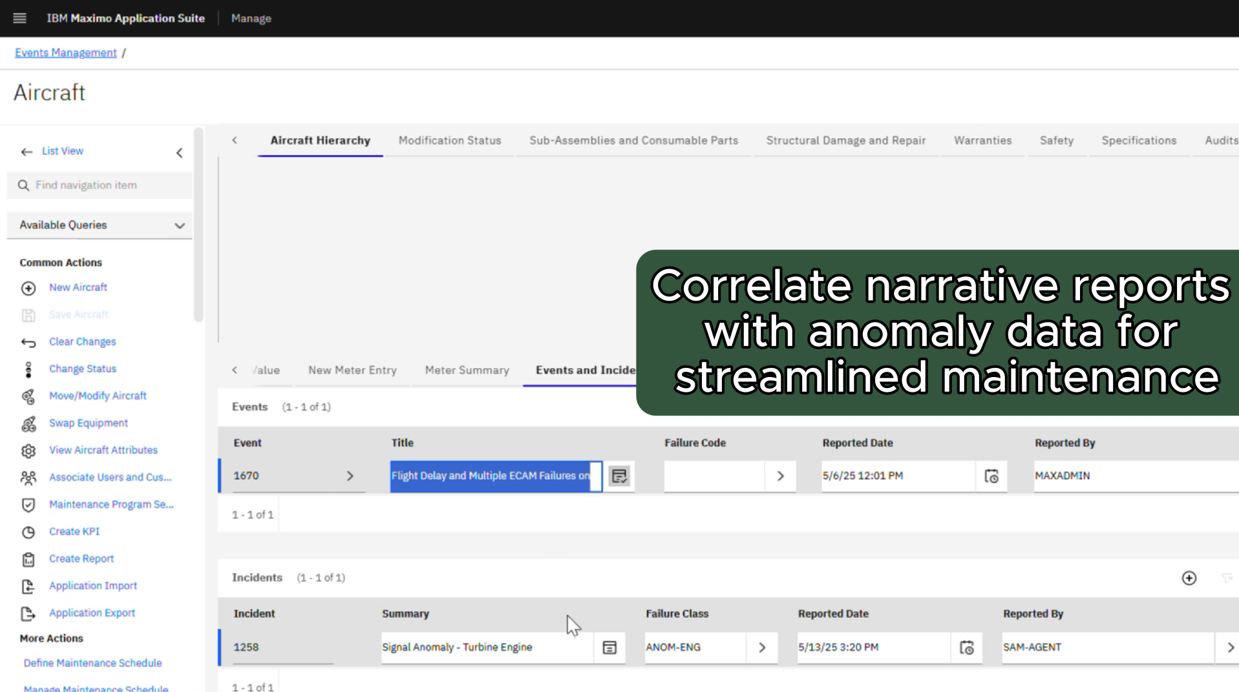

Slide 23
Agentic Anomaly Report
Real-time telemetry data streaming for fast issue detection
Efficiently track and resolve issues for operations teams
IBM Maximo
Asset Management
IoT Protocol
OCI Stream
Event
Trigger
REST API
ThingsBoard
OCI SAM
(MSET2)
Autonomous Data Warehouse
Numerical Telemetry Data
Aerospace signal data related to Jet Engine equipment signals on various aircrafts
Stored in Virtual Devices (OCI VM)
OAC-Native Direct Connection
OCI Data
Science
OCI VM
SAM Biz Analytics
(Oracle Analytics Cloud)
Apply advanced AI to detect abnormal behavior proactively
Visualize maintenance and business data for better decision-making

Slide 24
What’s Next?
Agentic AI for Intelligent Maintenance
Service Query
Asset Management Applications
User
Document
Understanding
IoT Signal Streaming
Anomaly Detection
Query Routing AI
Operations Manager AI
Communication & Collaboration Apps
Response
Audio & Video
Transcription
Digital
Assistant
Multimodal Documents
Team Collaboration AI
Planning & Critique
Issue Tracker & Ticketing Apps
Project
Requirements
Workflow & Task AI
Automation Agent
Project Manager AI

